Slide 1
Berry Full of DNA
DNA Structure and Function

Slide 2
TEKS
3 (E) evaluate models according to their limitations in representing biological objects or events
5 (A) describe the stages of the cell cycle, including deoxyribonucleic acid (DNA) replication and mitosis, and the importance of the cell cycle to the growth of organisms;
6 (A) identify components of DNA, and describe how information for specifying the traits of an organism is carried in the DNA
6 (C) explain the purpose and process of transcription and translation using models of DNA and RNA

Slide 3
BIG Ideas
The genetic code is in DNA.
DNA provides the template for DNA replication.
Nucleotides are the building blocks of DNA.
Enzymes facilitate the synthesis of DNA.

Slide 4
Take Away Knowledge
Recognize that traits are carried in DNA (central dogma).
Identify the components of DNA.
Describe DNA replication.
List and describe the role of enzymes in DNA synthesis and repair.

Slide 5
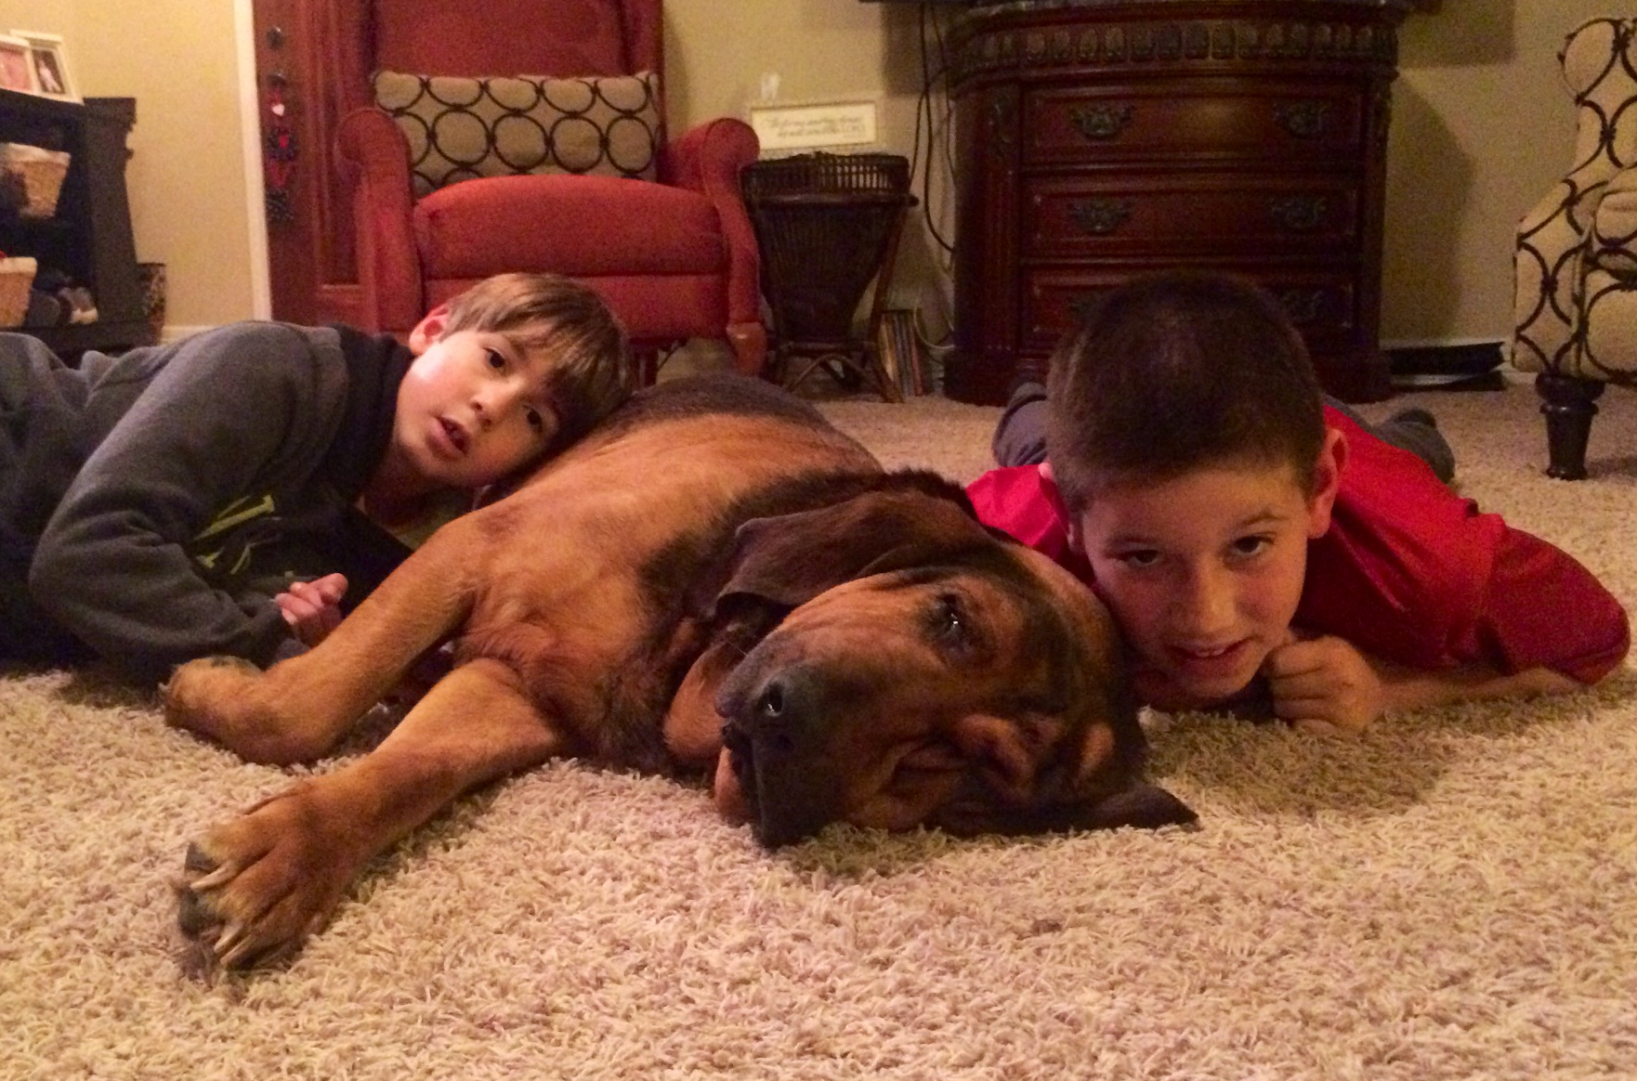
 Engage
Humans shed their entire epidermis (skin) every 15-30 days.
Bloodhounds track as few as 1 or 2 skin cells
4 billion olfactory receptor cells vs just 5 million in humans
Notes:
Humans shed their entire epidermis (skin) every 15-30 days.
Bloodhounds can track as few as 1 or 2 skin cells that belong to escaped prisoners, missing children or pets.
Bloodhounds have 4 billion olfactory receptor cells compared to humans who have just 5 million.

Slide 6
Think About It
How many cells does a human shed each day?
  On average, a human lose 50 million cells every day.
How do you think we are able to replace our entire epidermis so quickly?
  Cells are constantly dividing to replace those that are worn out or damaged.

Slide 7
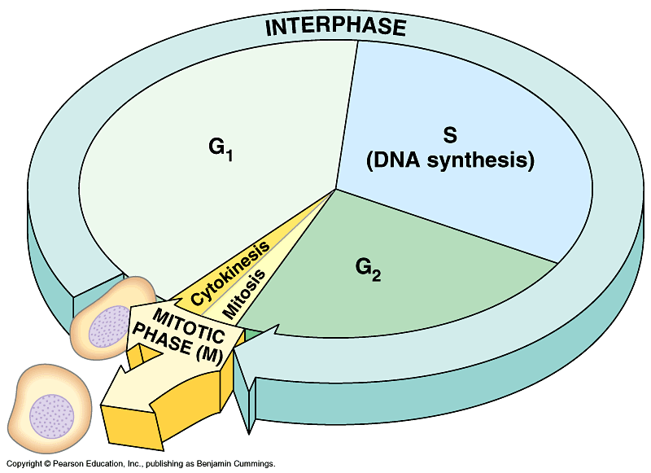
Cell Cycle Review

Slide 8
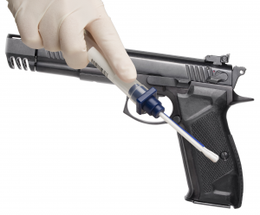
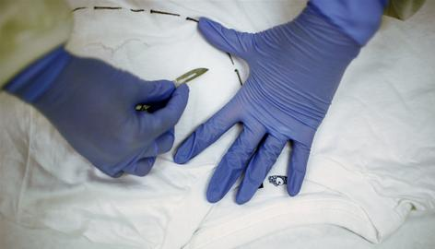
 ENgage
Touch DNA
Small DNA samples can be analyzed using this technology
Analysis of as few as 5-20 cells that might be left behind when one touches something such as clothing, weapons, or glass

Slide 9
Cell Cycle Review

Slide 10
Before you litter the room with more of your skin cells and DNA that we can’t see, let’s take a look at some DNA from strawberries to see what it actually looks like.

Slide 11
 Explore
Macro View
Berry Full of DNA
  Strawberries
  Bananas
  Liver
  Wheat Germ

Slide 12
 Explain
How did the appearance of the strawberries change as you added the extraction buffer and gently kneaded the bag?
  A whitish material appeared.
What do you think is happening in this step?
  The DNA (along with some proteins) is being removed from the strawberry.
Describe the appearance of the mixture when you first began to place the ice-cold alcohol on the strawberries with buffer solution.
  It looked a lot like a strawberry shake.

Slide 13
 Explain
Describe what happened when you first twirled the stick in or near the DNA-alcohol interface.
  A white, thread substance began to collect on the stick.
When you lifted the stick out of the tube and a fiber of DNA following, did you think that this was a single molecule of DNA? Why? Why not?
How would you describe the appearance of DNA to someone who has never seen it?
  It is white, thread-like, slimy.

Slide 14
Model View
Now that you understand a little about how DNA looks to the naked eye, we will specifically look at models for DNA structure on a molecular level.

Slide 15
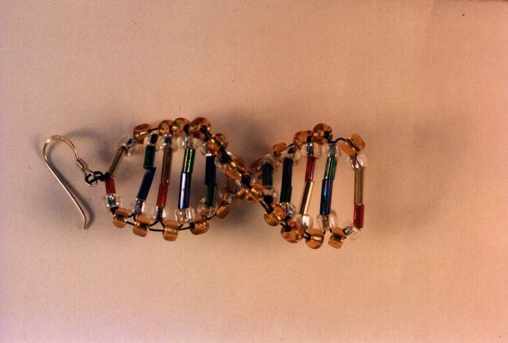
☹ Elaborate
DNA Jewelry

Slide 16
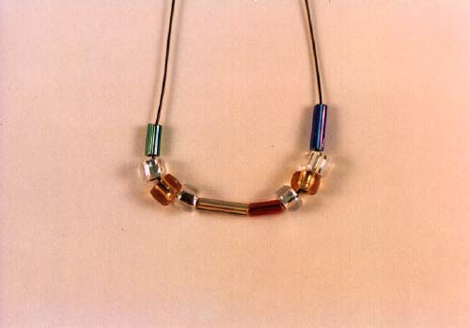

Slide 17
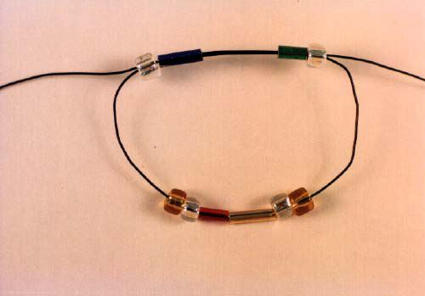

Slide 18
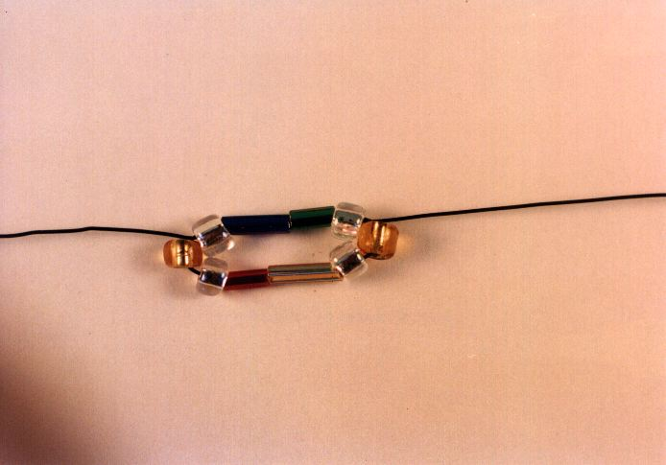

Slide 19
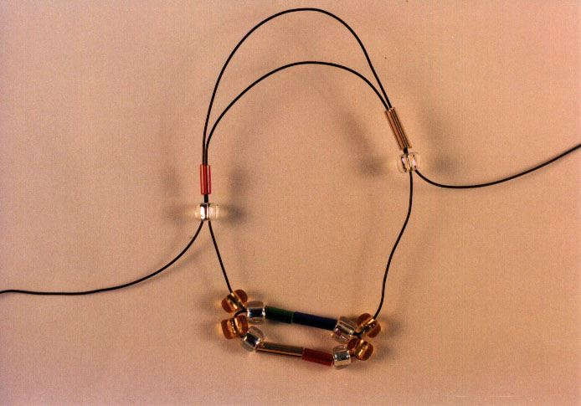

Slide 20
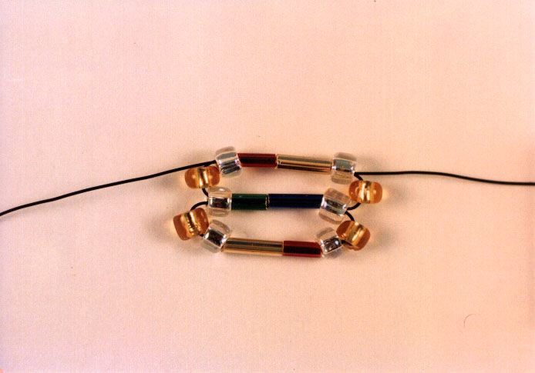

Slide 21
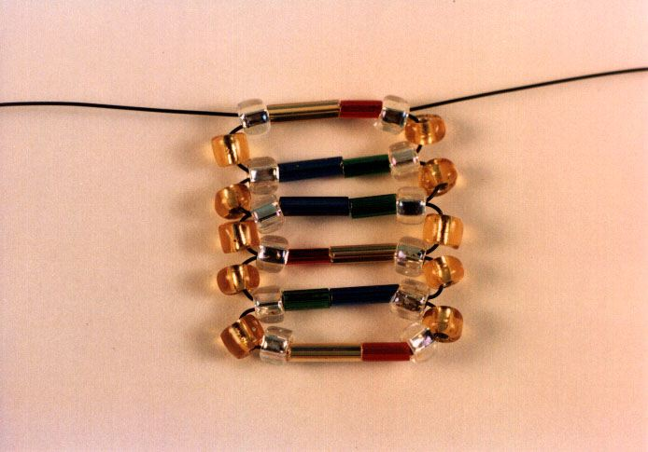

Slide 22
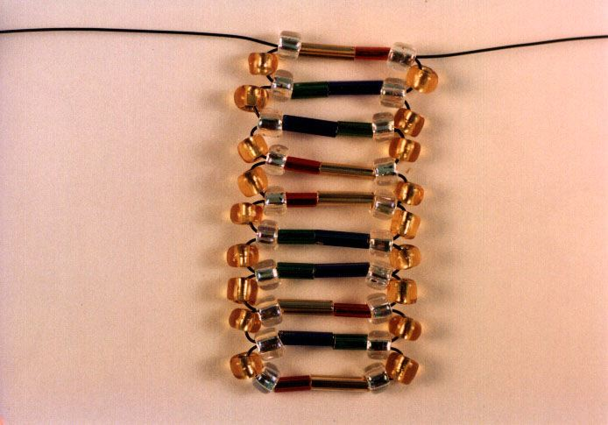

Slide 23
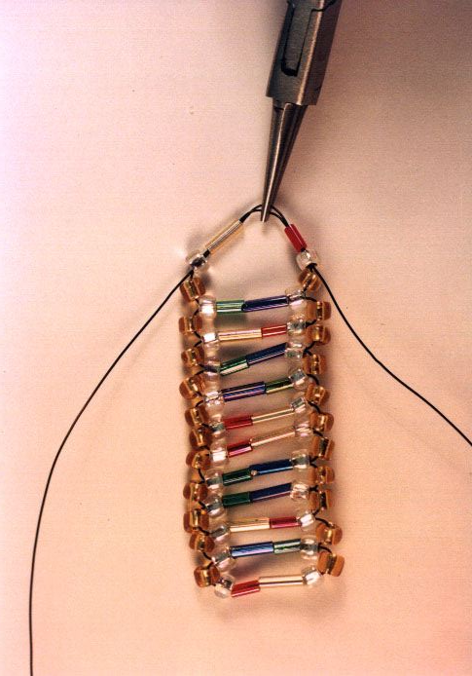

Slide 24
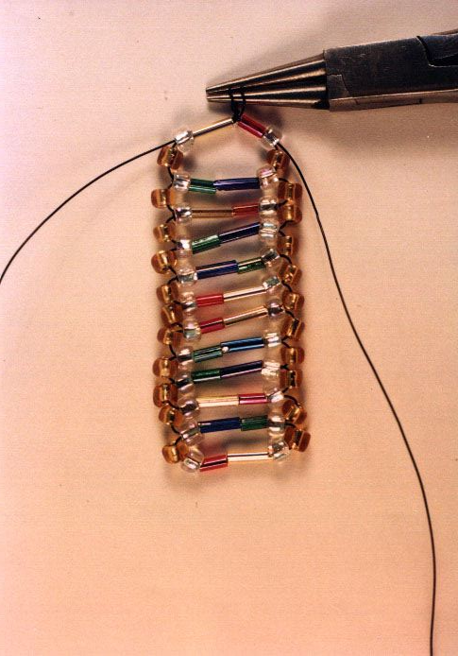

Slide 25
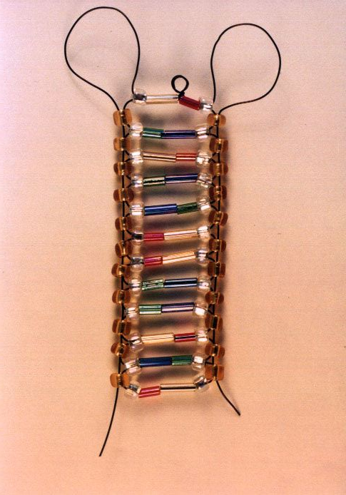

Slide 26
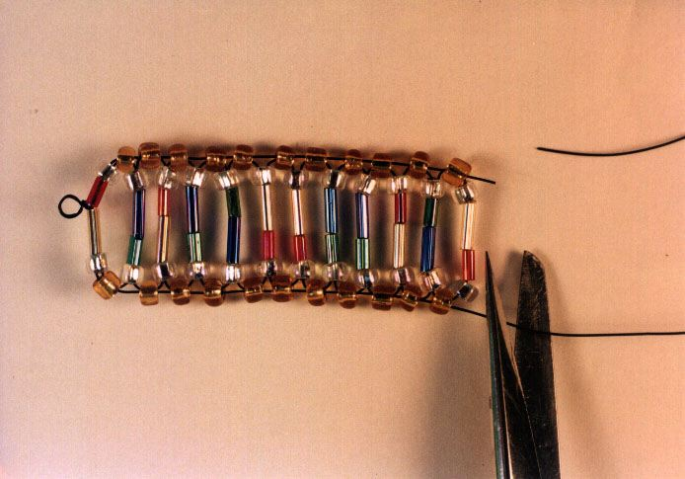

Slide 28
Debrief
Name the four nitrogen bases for DNA?
  Adenine, Guanine, Cytosine, Thymine.
How does our body get these bases or the materials to make these nitrogenous bases?
  Foods we eat
Name the type of bonding that holds the nitrogen bases together. Why is this type of bonding important during DNA replication?
  Hydrogen bonding. This type of bonding is weak and facilitates the unwinding and synthesis of the DNA.

Slide 29
Debrief
To what structure are the nitrogen bases attached?
  Deoxyribose sugar.
To which structures is the phosphate attached?
  The sugar.
How does one identify the 5’ end?
  The 5’ end begins with a phosphate.

Slide 30
Debrief
Which end of the DNA molecule is the sense strand? Why is it called the sense strand?
  The 5’ end is the sense strand. This strand is the one that carries the ordered code for making proteins.
List the molecules that make up the sides of the DNA ladder.
  phosphate and deoxyribose sugar.

Slide 31
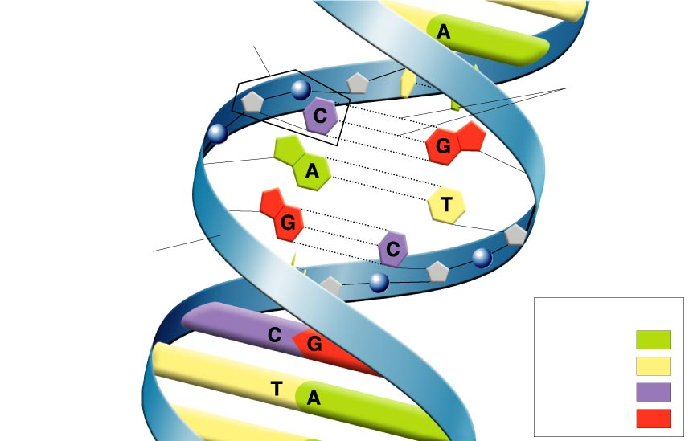
Diagram View
Nucleotide
Hydrogen bonds
Sugar-phosphate backbone
Key
Adenine (A)
Thymine (T)
Cytosine (C)
Guanine (G)
Notes:
This is where the teacher can now introduce increasingly complex information about the structure and function of DNA using diagrams (e.g., histones, 3’-5’, molecular structure of A, T, G, C).

Slide 32
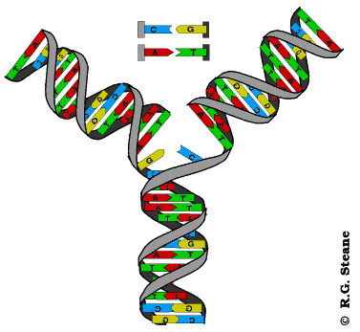
Replication

Slide 33
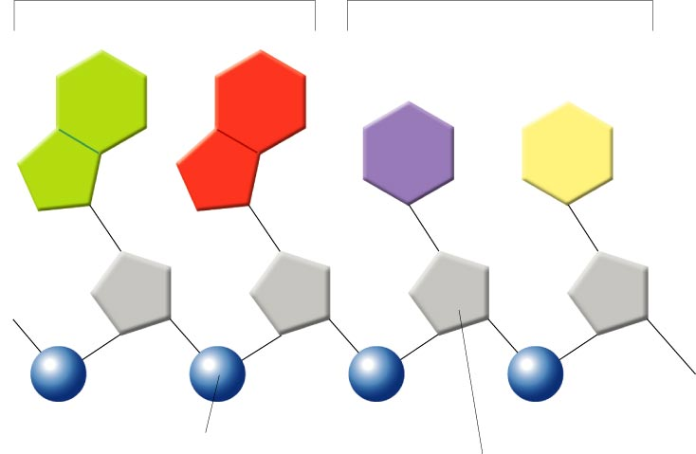
Diagram View
Nucleotides
Purines
Pyrimidines
Adenine
Guanine
Cytosine
Thymine
Phosphate group
Deoxyribose

Slide 34
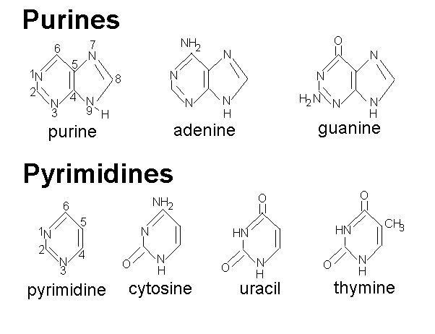
Bases
(Nitrogenous Bases)
Called nitrogenous bases because of the high content of nitrogen (N) atoms

Slide 35
So What’s the Big Deal?
We are proteins and protein interactions.
DNA carries all the code to make these proteins.
Understanding the structure of DNA helps us understand the association between things like skin cancer UV radiation as well as our own genetics passed to us by our parents. As researchers learn more about disease, our understanding of DNA guides the development of gene therapy and other practices that improve health and life.

Slide 36
Evaluate
After observing the extracted DNA and participating in a class discussion, the learner will document the observable characteristics of DNA in their journal. A grade of pass/fail will be given.
Using the internet, students will complete a chart with the two main parts of the cell cycle. A grade of pass/fail will be given.
Given a DNA model kit, students will construct a model of DNA with double-helical structure, nitrogenous bases correctly paired, alternating deoxyribose sugar and phosphate backbone, and hydrogen bonding correctly displayed scoring at least four out of five points on the rubric

Slide 37
Evaluate
DNA Model Rubric
0 points | 1 point | 2 points | 4 points | 5 points
Model is not helical, less than 5 nitrogen bases are correctly paired, less than 5 of the hydrogen bonds are accurately portrayed, and the sugar/phosphate backbone is incorrect | Model is helical, 5/9 nitrogen bases are correctly paired, 5/9 hydrogen bonding is accurately portrayed, and the sugar/phosphate backbone is correct. | Model is helical, 6/9 nitrogen bases are correctly paired, 6/9 hydrogen bonding is accurately portrayed, and the sugar/phosphate backbone is correct. | Model is helical, 7/9 nitrogen bases are correctly paired, 7/9 hydrogen bonding is accurately portrayed, and the sugar/ phosphate backbone is correct. | Model is helical, at least 8/9 nitrogen bases are correctly paired, 8/9 hydrogen bonding are accurate, and the sugar/phosphate backbone is correct.

