Slide 1
Dog Days of Summer

Slide 2
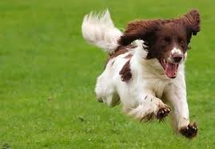

Slide 3
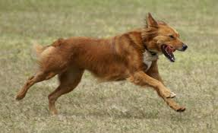

Slide 4
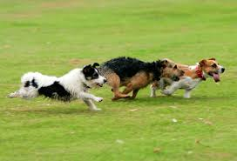

Slide 5
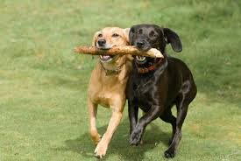

Slide 6
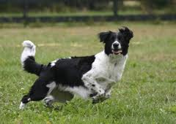

Slide 7
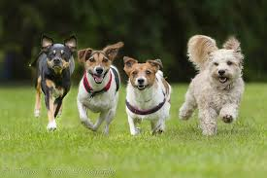

Slide 8
Most dogs love to run! My dog loves to run. I need to build a pen for my dog, but I want to give him as much space as possible to run around. What should I do?

