Slide 1
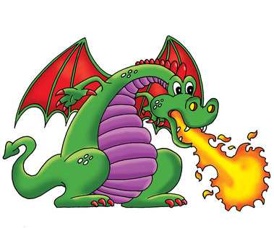
Dragon Genetics
TNT Summer Institute
July 10, 2014

Slide 2
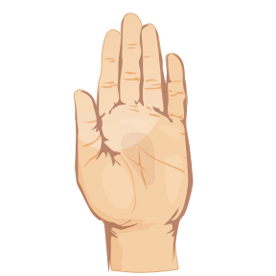
Engage!
Get two Post-It® notes
Clasp your hands together. Which thumb is on the top, the right or the left? Write this on Post-It® #1.
Are you right-handed or left-handed? Write this info on Post-It® #2.
Post your notes on the chart at the front of the room.

Slide 3
Explore!
Dragon Genetics Worksheet #3A: “Do Your Ears Hang Low?”
SBT paper
Finish the remainder of the table, filling in only the first column (10 minutes)
When you finish, go to the class chart and place a tic mark in the proper column for each trait.

Slide 4
Explore!
New vocabulary:
Dominant
form of a trait that will be expressed if an allele for the trait is present
Recessive
form of a trait that will be expressed only in the absence of a dominant allele
Phenotype
Appearance; physical expression of a trait.

Slide 5
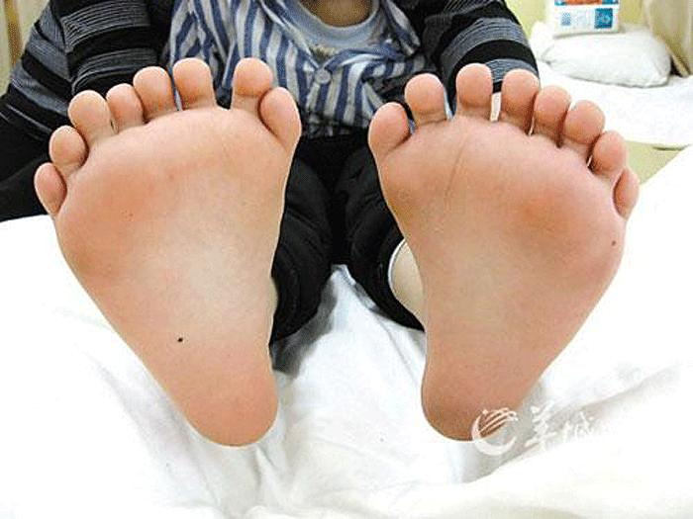
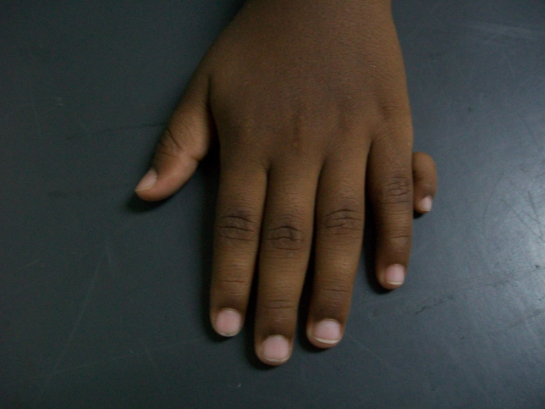
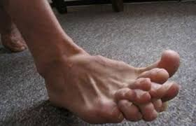
Explore!
Polydactyly:
The presence of more than five fingers or toes.
Occurs about 1/750 births

Slide 6
Explain!
Handout: “I’m All Keyed Up!”
What do upper-case letters represent?
dominant alleles (genes)
What do small-case letters represent?
recessive alleles
How do we inherit our alleles?
from our parents

Slide 7
Explain!
Handout #2: “Would Someone Please Take Charge?”
monohybrid cross
cross involving traits that have only 2 alleles
genotype
the actual alleles for a trait (ex: Ff, FF, ff)

Slide 8
Explain!
Homozygous
Two alleles that are identical (ex: TT, tt)
homozygous dominant = TT
homozygous recessive = tt
Heterozygous
Alleles for a trait are different (ex: Tt)
Complete WS #2

Slide 9
Explain!
Traits are encoded on cell structures called chromosomes.
Humans have 46 autosomal chromosomes.
How many are contributed from Mom?
23
How many are contributed from Dad?
23

Slide 10
Explain!
What is the genotype of a female?
XX
What is the genotype of a male?
XY
Which parent determines the sex of the offspring?
X
X
X
XX
XX
Punnett squares are used to show possible allele combinations.
Y
XY
XY

Slide 11
Elaboration- Dragon Genetics!
Materials:
Worksheet: “Dragon Genetics Activity #5”
1 set of dragon gametes
1 dragon blackline master
1 set of colored dragon parts
1 piece of green cardstock
Supply bag (scissors, glue sticks, tape, Sharpie, ruler)

Slide 12
Elaboration- Dragon Genetics!
Find the person who has the egg or sperm with the number that matches yours.
Open the gametes and pair up the chromosomes.
Determine your baby dragon’s genotype and phenotype. Use the second page of the worksheet as a data table.
Cut out the colored pieces that correspond to the genotype and build your baby dragon. Use tape or glue to construct the baby on the cardstock. Label the structures with their genotype and phenotype.

Slide 13
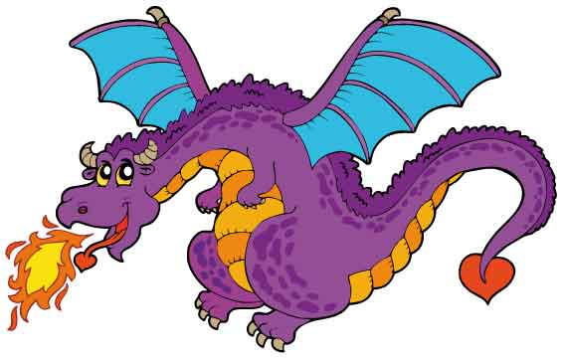
Elaboration- Dragon Genetics!
Once you finish your baby dragon, post them on the cabinet doors for all to see!

Slide 14
Elaboration
Three (3) types of genetic dominance:
1. Complete dominance*
Two alleles code for a trait, but only the
dominant one is expressed.
Incomplete dominance
The heterozygous genotype displays a
phenotype intermediate between the
dominant and recessive form.
Codominance
Two types of alleles act as dominants.

Slide 15
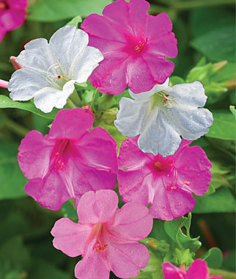
Elaboration
Incomplete dominance
Example: 4-O’Clock flowers
RR = red flower
rr = white flower
Rr = pink flower
R
r
R
RR
Rr
r
Rr
rr

Slide 16
Elaboration
Codominance Example: blood typing
A and B act as dominants.
O is recessive
Type A = AA or AO
Type B = BB or BO
Type AB = AB
Type O = OO
A
O
B
AB
BO
O
AO
OO

Slide 17
Evaluation
Complete the post-test!

