Slide 1
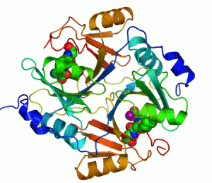
Breaking Up Can be Easy to Do or Come Together Right Now

Slide 2
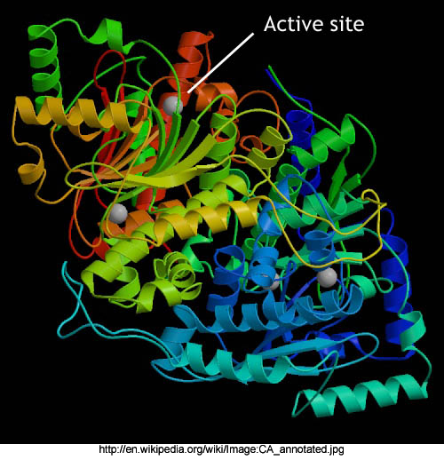
BIO 9 (C)
Identify and investigate
the role of enzymes.

Slide 3
BIG Ideas
Enzymes are proteins that catalyze enzyme reactions
Enzyme efficacy is influenced by nonspecific variables such as pH, temperature, and concentration.
Enzyme inhibitors reduce or completely inhibit enzyme catalytic action via interactions with enzyme active site(s).

Slide 4
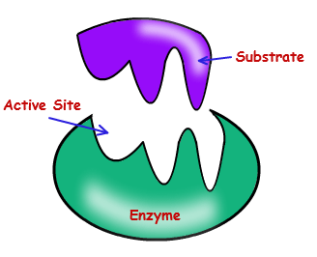
The Takeaway Knowledge
What is the role of an enzyme within cells?
Explain enzymatic specificity.
Compare and contrast the Induced Fit Hypothesis and the Lock and Key Hypothesis.
List and explain two types of inhibitors used to regulate enzymatic activity.
Describe three reversible inhibitors and give an example for each type.
Name three variables that affect enzyme activity

Slide 5
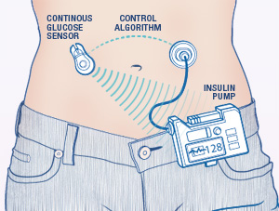
ENGAGE
Welcome Shirley Bonkowski who is going to talk about her enzyme replacement therapy.

Slide 6
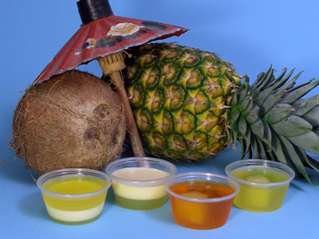
EXPLORE
Nonspecific Inhibitors:
Exploring the Effect of Heat on Pineapple Enzymes

Slide 7
EXPLAIN
Describe the results of adding fresh pineapple juice to Jell-O™.
The Jell-O™ began to break down and this disintegration increased over time.
Describe the results of adding canned pineapple juice to Jell-O™.
The Jell-O™ broke down a little and there was little change over time.

Slide 8
Compare and contrast the two results. Make inferences about the different observations.
  Form some reason, the fresh pineapple was more potent in terms of breaking down the Jell-O™. Since enzymes are denatured by heat, the canning process would have destroyed the some natural substance (bromelin enzyme) in the pineapple.
Based on the results of this experiment, what claim might you make about enzymes; what they do and how they are affected by temperature?
  Enzymes are involved in catabolic processes. That is they break down certain substances. The enzymes are also affected by variables such as temperature which is why the canned pineapple juice had little effect on the Jell-O™.

Slide 9
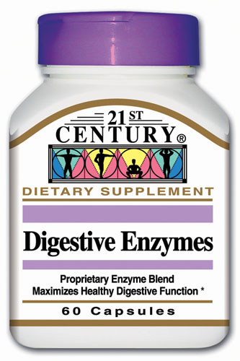
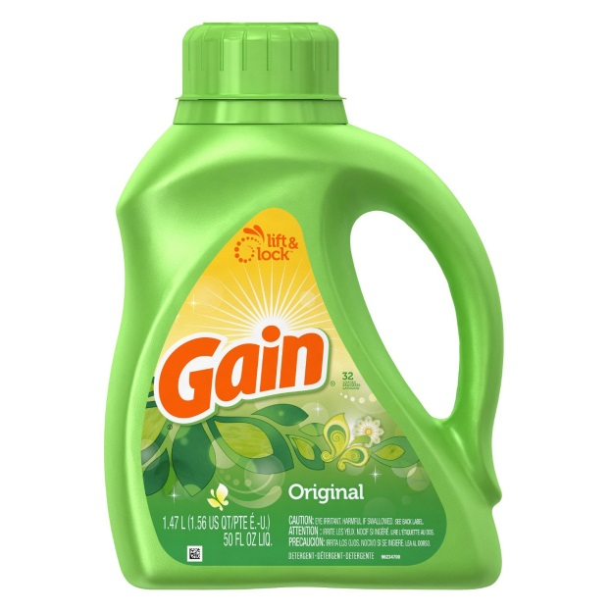

What did you learn from the reading materials about enzyme uses?
  Answers will vary, but should include common uses of enzymes to aid digestion, clean clothing, and treatment of wounds. The names of specific enzymes and the source of the enzyme are also discussed.

Slide 10
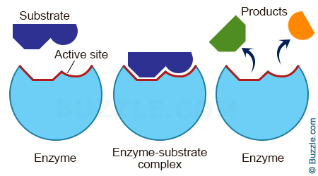
☹ELABORATE
What happens when you pull on the molecule of lactose?
  The glucose and galactose molecules are separated. These are called products of the interaction.
Some people are lactose intolerant? How do you think this mechanism works in their body?
  These individuals do not produce enough of the lactase enzyme and so the undigested lactose stays in their body until it is broken down by bacteria. During the meantime, this person may experience nausea, gas, bloating, stomach ache, and diarrhea.
What do you notice about the Lactase enzyme?
  The enzyme is unchanged.
What do you notice about the fit between the enzyme and the substrate?
  They fit together like a puzzle piece. There was a slight shape change when they were pulled apart.

Slide 11
Catabolism

Slide 12
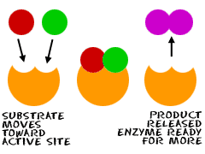
Anabolic Activity
What happens when you pull on the DNA building blocks?
  The nucleotides stay together. These are called products of the interaction.
Explain why this is an example of anabolism?
  The building blocks of DNA are brought together to form a product.
What do you notice about the DNA polymerase enzyme?
  The enzyme is unchanged.
What do you notice about the fit between the enzyme and the substrate?
  They fit together like a lock and key. Unlike catabolism, the enzyme did not change shape once the small building block of DNA was in the active site.

Slide 13
Anabolic Activity
Induced fit

Slide 14
Competitive Inhibition
What happens when the competitive inhibitor, Antabuse interacts with the enzyme?
    The normal metabolism of alcohol is prevented and toxins build up in the body making the person sick. This stops further products from being formed.
What happens when the substrate, acetaldehyde interacts with the enzyme acetaldehyde dehydrogenase?
    The alcohol continues be metabolized...

Slide 15
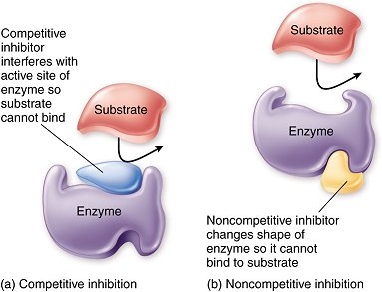
Competitive Inhibition
What do you notice about the acetaldehyde dehydrogenase enzyme?
  The enzyme is unchanged.
What do you notice about the fit of the substrate and the competitive inhibitor?
  The competitive inhibitor fits within the active site and blocks the substrate.
How would a very low dosage of Antabuse affect an individual?
  The effects would not be as severe if the concentration of the competitive inhibitor was low.
What do you notice about the polarity of the enzyme and substrate?
  This particular active site is specific with regard to polarity.

Slide 16
Competitive Inhibition

Slide 17
Noncompetitive Inhibition
What happens when the noncompetitive inhibitor, Nevarapine interacts with the enzyme?
  The active site experiences a shape change and the interactions which synthesize viral DNA are stopped.
  Since Nevarapine does not bind to the active site, what happens to the HIV?
    The HIV remains in the body, but the production of HIV slows so there are fewer HIV-infected cells.
What inferences might be made about the concentration of Nevarapine in the body?
  With an appropriate dosage of Nevarapine, it is more likely that the cells will remain uninfected.
How is noncompetitive inhibition different from competitive inhibition?
  There is no occupation of the active site; there is a shape change to the active site, the concentration of the substrate during noncompetitive inhibition is inconsequential.

Slide 18
Noncompetitive Inhibition

Slide 19
Evaluate
Name four types of macromolecules.
2. What is the function of an enzyme?
3. Describe the difference between the lock and key and the induced fit hypothesis for enzyme interactions.

Slide 20
Name variables that affect enzyme activity?
5. Name two types of inhibitors other than reversible inhibitors.
6. Describe three reversible inhibitors and give an example for each type.

Slide 21
Images
https://legacy.etap.org/demo/biology/lesson9/kep22.jpg
http://www.mayo.edu/research/~/media/kcms/gbs/research/images/2013/03/07/14/54/de11-2-artificial-pancreas-diagram.ashx
http://www.myscienceproject.org/j5img/pineapple.jpg
http://www.swansonvitamins.com/en_US/images/ItemImages_SW/images_Xl/CNT048_Xl.jpg
http://www.toptenepic.com/wp-content/uploads/Grab-Green-3-in-1-Laundry-Detergent.jpg
http://www.frost.com/prod/servlet/cio/MKEE-5JAN53/image1-2.jpg

