Slide 1
Activity
QuickDraw

Slide 2
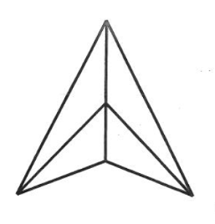
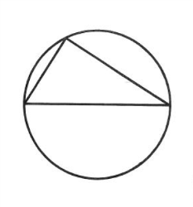
Quick Draw:
Quick Draw #1
Quick Draw #2

