Slide 1
It won’t hurt you, really!! A brief introduction to the TI-Nspire
Prepared and Presented by
Casey Harl

Slide 2
Introduction
Casey Harl –
e-mail – charl@ldisd.net
Web site – http://classroom.ldisd.net/webs/CHARL/
8th grade math and Algebra 1 at Lake Dallas Middle School

Slide 3
Using the N-Spire in the classroom
Two obstacles to utilizing the N-Spire in MS and HS classrooms
Don’t have the technology available
Grants – education.ti.com/educationportal/sites/US/sectionHome/grantandfunding.html
Department budgets – Buy a few at a time over several years
Proofs of Purchase from previous purchases
Teachers Edition Software – Pick up at TI booth or talk with your TI representative
Teachers not familiar with technology – Several options
Play!!!
On-line Training videos and webinars
N-spire Cliff Notes
1-800-TICARES
T^3 training

Slide 4
Key Concepts
Handheld computer
7 Major Applications
Calculator – You’ve seen this before!
Graphing – Better resolution and integration than 84+
Geometry – Similar to Cabri or Geometer’s Sketchpad
Lists and Spreadsheet – Rudimentary spreadsheet, but MUCH better than 84+ Lists
Data and Statistics – Charts and statistical analysis
Notes – I doubt you’ll ever use it … unless you have a Navigator System, and then you will use it to create student documents
Vernier Data Capture
ALL NEW – Scratchpad for doing quick calculations and graphs

Slide 5
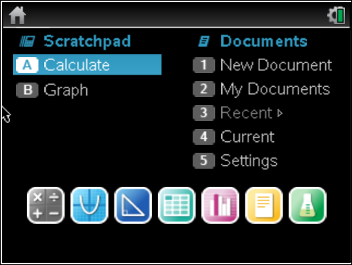
Let’s Go Home!
Similar to My Documents on your PC.
Scratchpad – Quick Calcs or Graphs
Calculator
Graphing
Geometry
List/ Spreadsheet
Data and Statistics
Notes
Vernier Data App

Slide 6
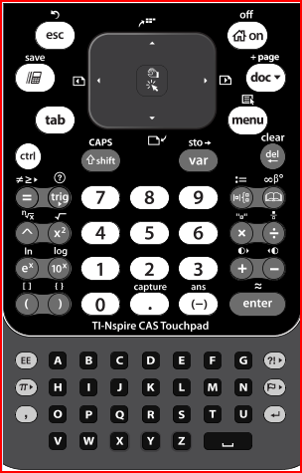
Key Keys – New Keypad
Esc – just like a PC
CTRL – Esc – Undo key
Home Key – Takes you back to Home Screen
Menu Key – App specific menu options.
- CTRL Menu is like a mouse “right click.”
Works like the “2nd” key on the 84+
Scratchpad - Place to do quick calculations and graphs
Touchpad (or Mouse) – middle is like clicking a mouse to select

Slide 7
Let’s Play!!!!
Turn to the N-Spiring Play Sheet
Turn On your N-spire
Press HOMEc → 1 – New Doc
Press 2 – Add Graphs
Spend the next 10-15 minutes following the sheet and “playing”
Try to answer all the questions!
Demo Teacher’s Edition Software
Magical Graphs
Lists
Data Analysis

Slide 8
How to use N-spire in classroom
Suggested Web-sites
TI Math - www.timath.com
N-Spired Math Activities – www.ti-mathnspired.com/
N-Spired Quick Clicks – www.ti-mathnspired.com/quickclicks/

Slide 9
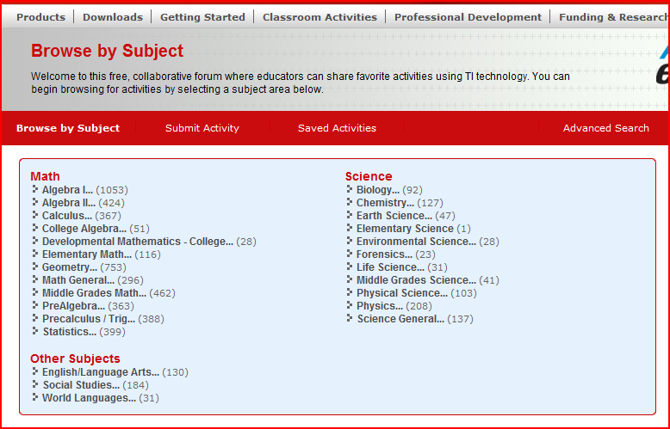
How to use the N-spire in classroom
Activities Exchange – education.ti.com
Click Classroom Activities – Activities Exchange

Slide 10
Where to Learn More
1-800-TICARES – Answer questions ranging from “How to” to “It’s broken!” to “HELP I’m in the middle of class and ….”

Slide 11
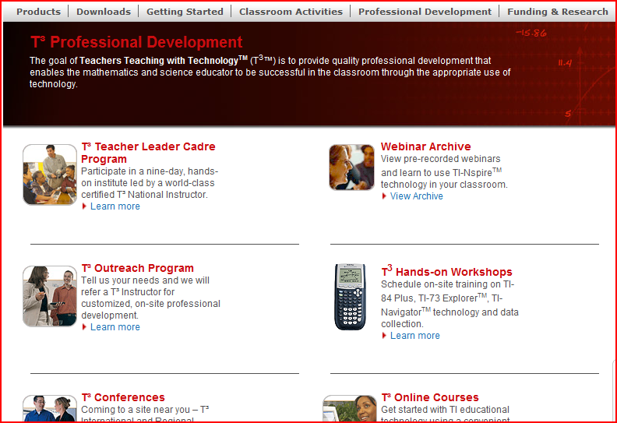
Where to Learn More
TI – education.ti.com
Under the Professional Development Tab
T^3 Online Course – FREE!
T^3 Webinars, Conferences, and Workshops

Slide 12
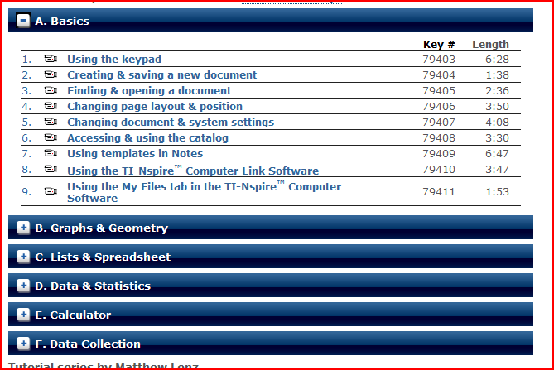
Where to Learn More
Atomic Learning – EVERYTHING N-Spire!! www.atomiclearning.com/k12/ti_nspire

